Slide 1
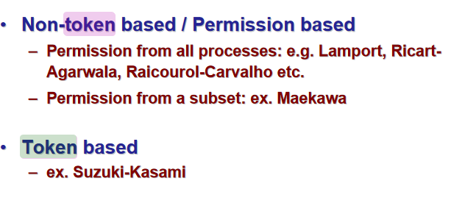
Data Structures Week 1

Slide 2

Maekawa’s Algorithm: Key Idea
Ricart-Agrawala requires replies from all processes in group
Maekawas Algorithm instead, get replies from only some processes in group
But ensure that only one process is given access to CS (Critical Section) at a time
Paper: https://cseweb.ucsd.edu/classes/wi09/cse223a/p145-maekawa.pdf
Notes:
https://cseweb.ucsd.edu/classes/wi09/cse223a/p145-maekawa.pdf

Slide 3

Maekawa’s Algorithm
Permission obtained from only a predecided subset of other processes, called the Request Set (or Quorum)
Separate Request Set, R_{i}, for each process i
Requirements:
    for all i, j: R_{i} ∩ R_{j} ≠ Φ
    for all i: i Є R_{i}
    for all i: |R_{i}| = K, for some K
    any node i is contained in exactly D Request Sets

Slide 4
Maekawa’s Algorithm
The processes in the intersection of the request sets of two processes Pi and Pj, will intercede to decide who of the two should enter as they are aware of both Pi and Pj being interested.

Slide 5
A Simple Version
To request critical section:
    i sends REQUEST message to all process in R_{i}
On receiving a REQUEST message:
    Send a REPLY message if no REPLY message has been sent since the last RELEASE message is received.
    Update status to indicate that a REPLY has been sent.
    Otherwise, queue up the REQUEST
To enter critical section:
    i enters critical section after receiving REPLY from all nodes in R_{i}

Slide 6
A Simple Version contd..
To release critical section:
    Send RELEASE message to all nodes in R_{i}
    On receiving a RELEASE message, send REPLY to next node in queue and delete the node from the queue.
    If queue is empty, update status to indicate no REPLY message has been sent.
  Algorithm does not mention how the next node is selected among the requesting nodes in the queue. We could assume that the next node is the next node in queue or process with lowest time stamp.

Slide 7
Quorum Based Algorithms
{Maekawa’s algorithm}
- First solution with a sublinear O(sqrt N) message complexity.
- “Close to” Ricart-Agrawala’s solution, but each process is required to obtain permission from only a subset of peers

Slide 8
Maekawa’s algorithm
With each process i, associate a subset S_{i}. Divide the set of processes into subsets that satisfy the following two conditions:
i ∈ S_{i}
∀i,j : 0≤i,j ≤ n-1 S_{i} ⋂ S_{j} ≠ ∅
Main idea. Each process i is required to receive permission from S_{i} only. Correctness requires that multiple processes will never receive permission from all members of their respective subsets.
S₀
S₁
0,1,2
1,3,5
2,4,5
S₂

Slide 9
Maekawa’s algorithm
Example. Let there be seven processes 0, 1, 2, 3, 4, 5, 6
S₀ = {0, 1, 2}
S₁ = {1, 3, 5}
S₂ = {2, 4, 5}
S₃ = {0, 3, 4}
S₄ = {1, 4, 6}
S₅ = {0, 5, 6}
S₆ = {2, 3, 6}

Slide 10
Maekawa’s algorithm-version 1
ME1. At most one process can enter its critical section at any time.
Let i and j attempt to enter their Critical Sections
S_{i} ∩ S_{j} ≠ ∅ implies there is a process k ∊ S_{i} ⋂ S_{j}
Process k will never send ack to both.
So it will act as the arbitrator and establishes ME1
S₀ = {0, 1, 2}
S₁ = {1, 3, 5}
S₂ = {2, 4, 5}
S₃ = {0, 3, 4}
S₄ = {1, 4, 6}
S₅ = {0, 5, 6}
S₆ = {2, 3, 6}

Slide 11
Maekawa’s algorithm-version 1
Is deadlock possible ??

Slide 12






Data Structures Week 1
P1, P2 and P3 are the
processes interested in the CS
A1, A2 and A3 are the
respective arbitrators btwn
the processes as shown
A deadlock as seen is possible
A1
P2
P1
A2
A3
P3

Slide 13
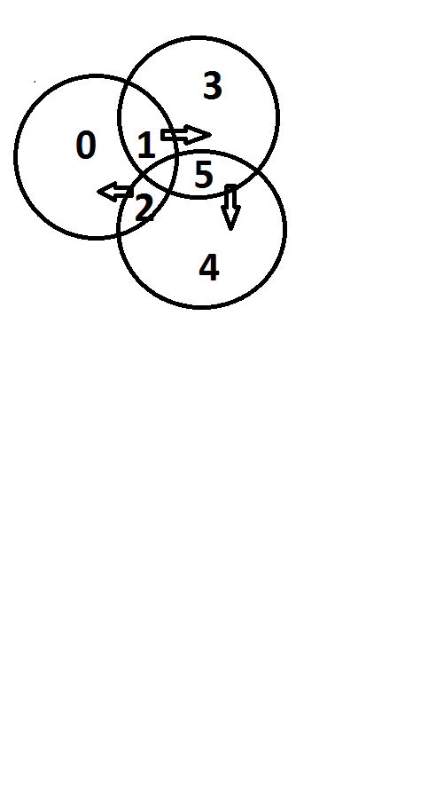
Maekawa’s algorithm-version 1
ME2. No deadlock.
Unfortunately deadlock is possible! Assume 0, 1, 2 want to enter their critical sections.
From S₀= {0,1,2}, 0,2 send ack to 0, but 1 sends ack to 1;
From S₁= {1,3,5}, 1,3 send ack to 1, but 5 sends ack to 2;
From S₂= {2,4,5}, 4,5 send ack to 2, but 2 sends ack to 0;
Now, 0 waits for 1 (to send a release), 1 waits for 2 (to send a release), , and 2 waits for 0 (to send a release), . So deadlock is possible!
S₀ = {0, 1, 2}
S₁ = {1, 3, 5}
S₂ = {2, 4, 5}
S₃ = {0, 3, 4}
S₄ = {1, 4, 6}
S₅ = {0, 5, 6}
S₆ = {2, 3, 6}
0
1
2

Slide 14
Data Structures Week 1
S₀ = {0, 1, 2}
S₁ = {1, 3, 5}
S₂ = {2, 4, 5}
S₃ = {0, 3, 4}
S₄ = {1, 4, 6}
S₅ = {0, 5, 6}
S₆ = {2, 3, 6}
Process 0, 1 and 2 are the
processes interested in the CS
A1=1, A2=5 and A32 are the
respective arbitrators btwn
the processes as shown
A deadlock as seen is possible
A1=1
P2=1
P1=0
A2=5
A3=2
P3=2

Slide 15

Features
Message Complexity:
Synchronization delay =
    2*(max message transmission time) [since a release request and a reply to next queued request to be done.]
Major problem: DEADLOCK possible
Need three more types of messages (FAILED, INQUIRE, YIELD) to handle deadlock.
    Message complexity can be 5*sqrt(N)

Slide 16
Maekawa’s algorithm-Version 2
Version 2 uses three additional messages: At site Sk
- failed (if reply already given to someone else with higher priority)
- inquire: An inquire msg is sent by Sk when a higher priority request has reached it( to check if the request granted process Si is already in CS ). If Si has received a failed from someone else then Si will respond with a yield to Sk. Then, Sk will put Si on the queue to allow his request at a later point and will reply to the site with higher priority.
- Yield (process got failed from one of the other processes so it relinquishes its desire to enter CS for now)
Notes:
Time 13:38 of Lecture 15

Slide 17
Maekawa’s algorithm-Version 2
However if it is already in CS, it will send RELEASE only after finishing CS.s

Slide 18
Data Structures Week 1
EXAMPLE

Slide 19
Features
Message Complexity: 5*sqrt(N)
Synchronization delay =
    2*(max message transmission time) [since a release request and a reply to next queued request to be done.]
DEADLOCK free

